Slide 1

INVENTORY MANAGEMENT SYSTEM (IMS) PROJECT MANAGEMENT UNIT

Slide 2


Introduction to Digital Services
Digital Services of the ECP, designed and deploying by PMU, offers various Softwares under a unified dashboard.
Strengthens the spectrum of e-services for utilization by the Concerned Wings of the ECP.
Leads to Faster Services, improved Data Management, upgraded System Security, more transparency and elevated levels of Public Trust.

Slide 3

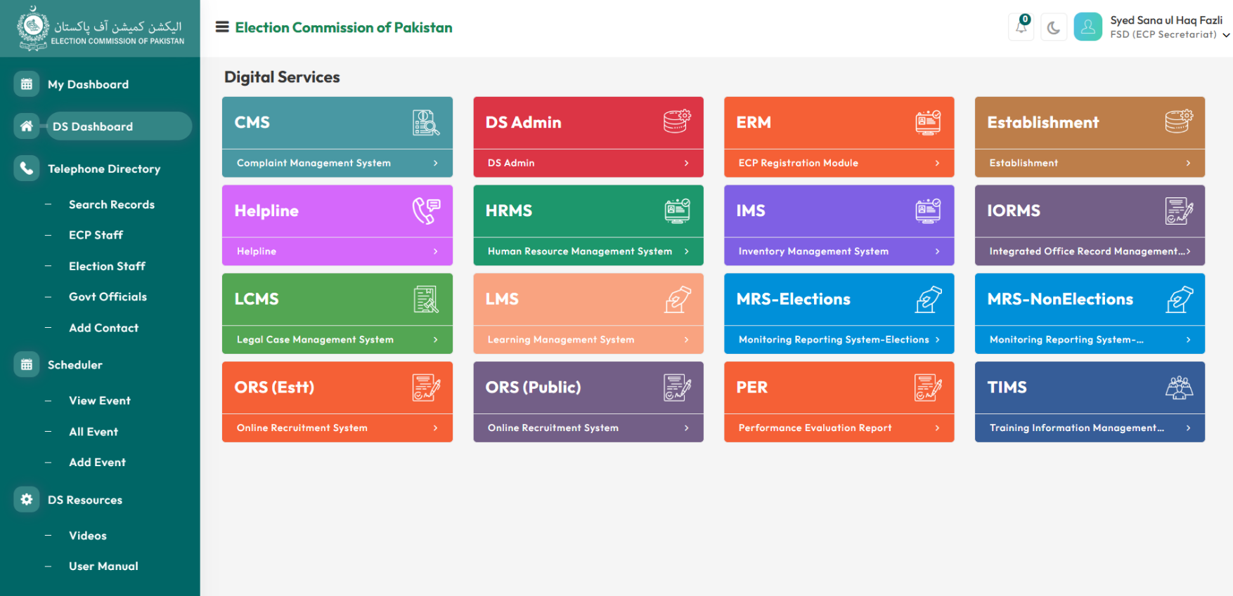
Digital Services
Complaint Management System (CMS)
Legal Case Management System (LCMS)
Training Information Management System (TIMS)
DS Admin
ECP Registration Module (ERM)
Establishment
Inventory Management System (IMS)
Human Resource Management System (HRMS)
Integrated Office Record Management System (IORMS)
Learning Management System (LMS)
Monitoring & Reporting System (MRS)
Online Recruiting System (ORS)
Telephone Directory
Scheduler

Slide 4


Inventory Management System (IMS)
Enterprise-grade web-based inventory platform
Multi-location inventory management with hierarchical control
Integrated procurement and stock issuance workflows
Real-time inventory tracking and reconciliation
Multi-level approval workflows with role-based access
Production-ready system managing unlimited items across multiple locations

Slide 5


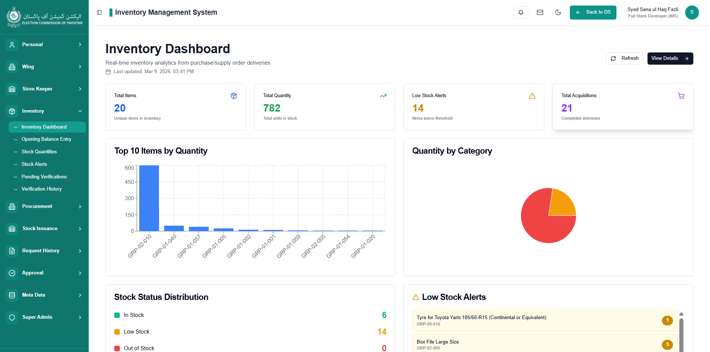
Inventory Management System

Slide 6
Key IMS Features
✅ Real-time Stock Tracking
✅ Multi-Step Hierarchical Approval Workflows
✅ Complete Audit Trail
✅ Role-Based Access Control (RBAC)
✅ Three-Level Inventory Management
✅ Multiple Tender Types Support
✅ Digital Annual Framework Contracts
✅ Serial Number & Equipment Tracking
✅ Document Upload & Attachment Support
✅ Soft Delete with Data Recovery

Slide 7
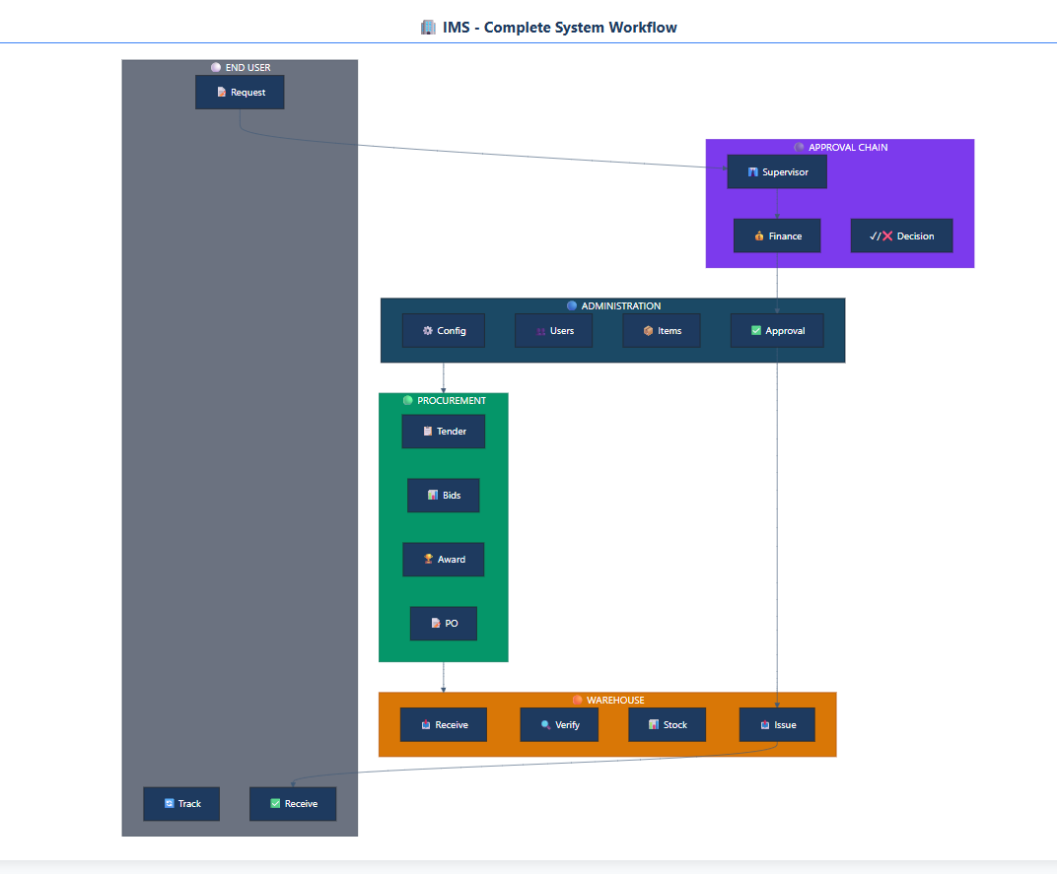
Complete IMS Workflow

Slide 8
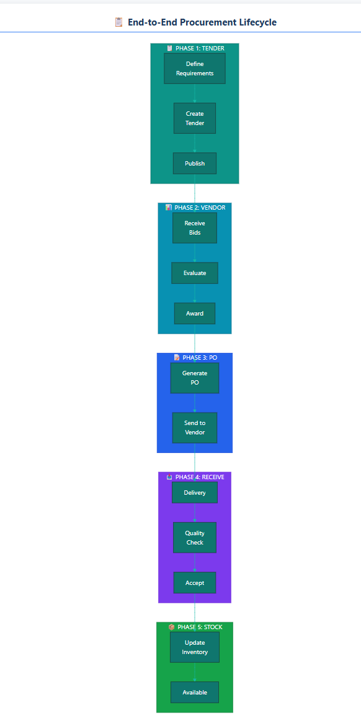
End-to-End Procurement Lifecycle

Slide 9
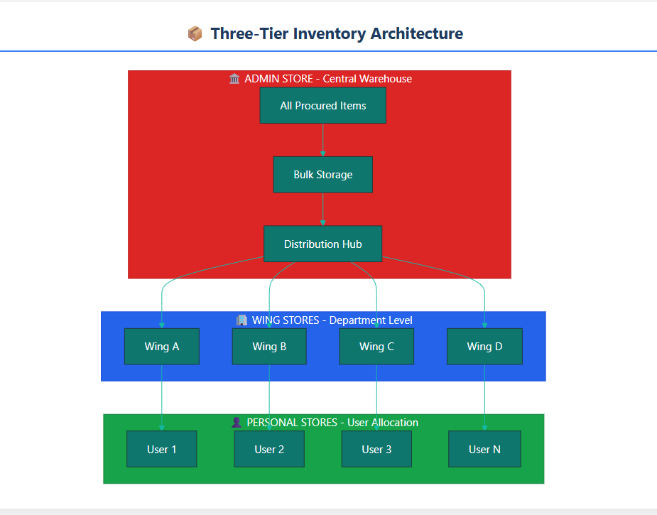
Three-Tier Inventory Architecture

Slide 10
STOCK ACQUISITION (Procurement)
CORE MODULES
Tender management (Tender, Patty-Purchase)
Vendor evaluation and bidding
Purchase order creation and tracking

Slide 11
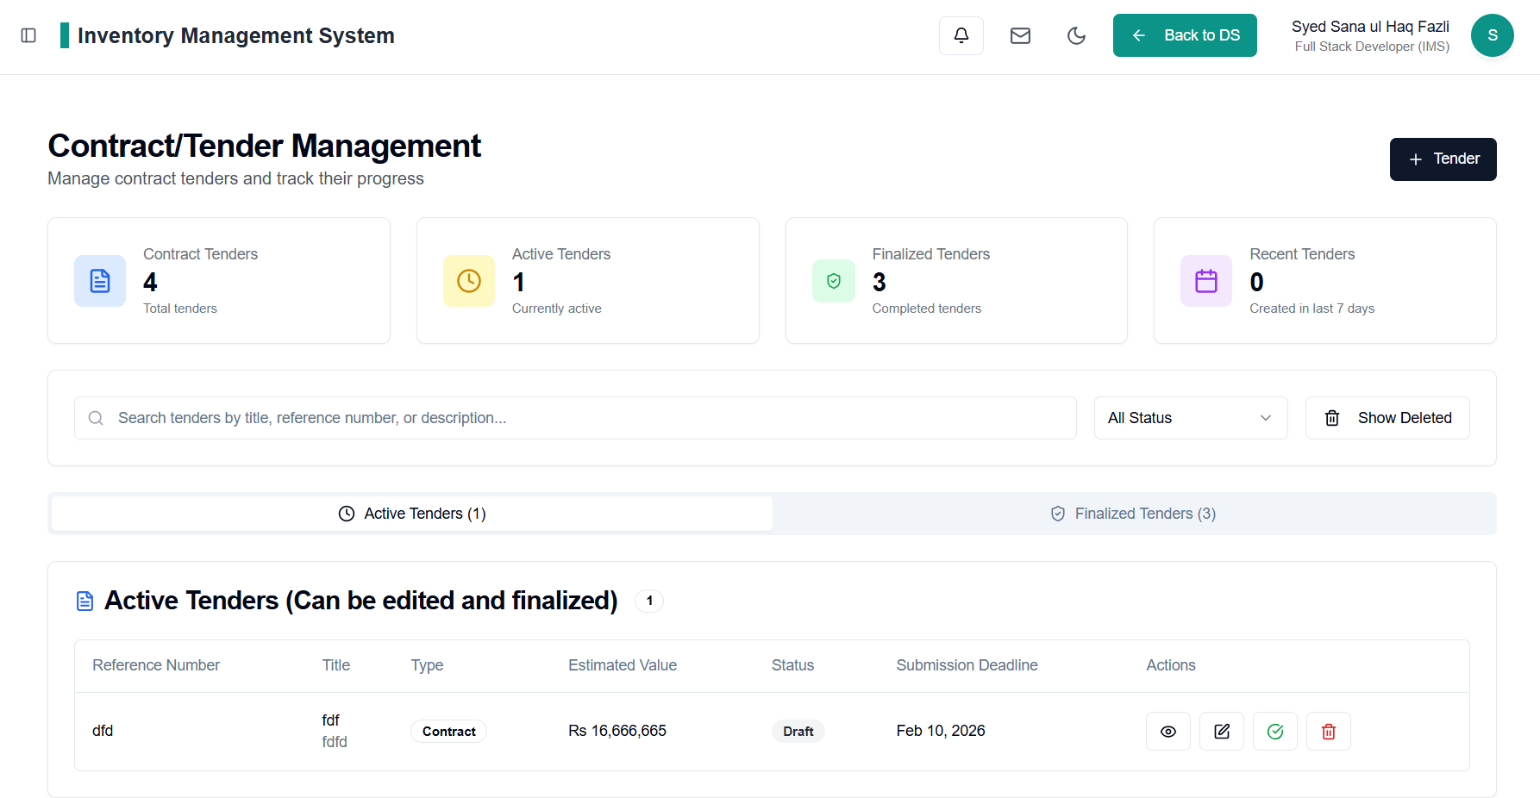
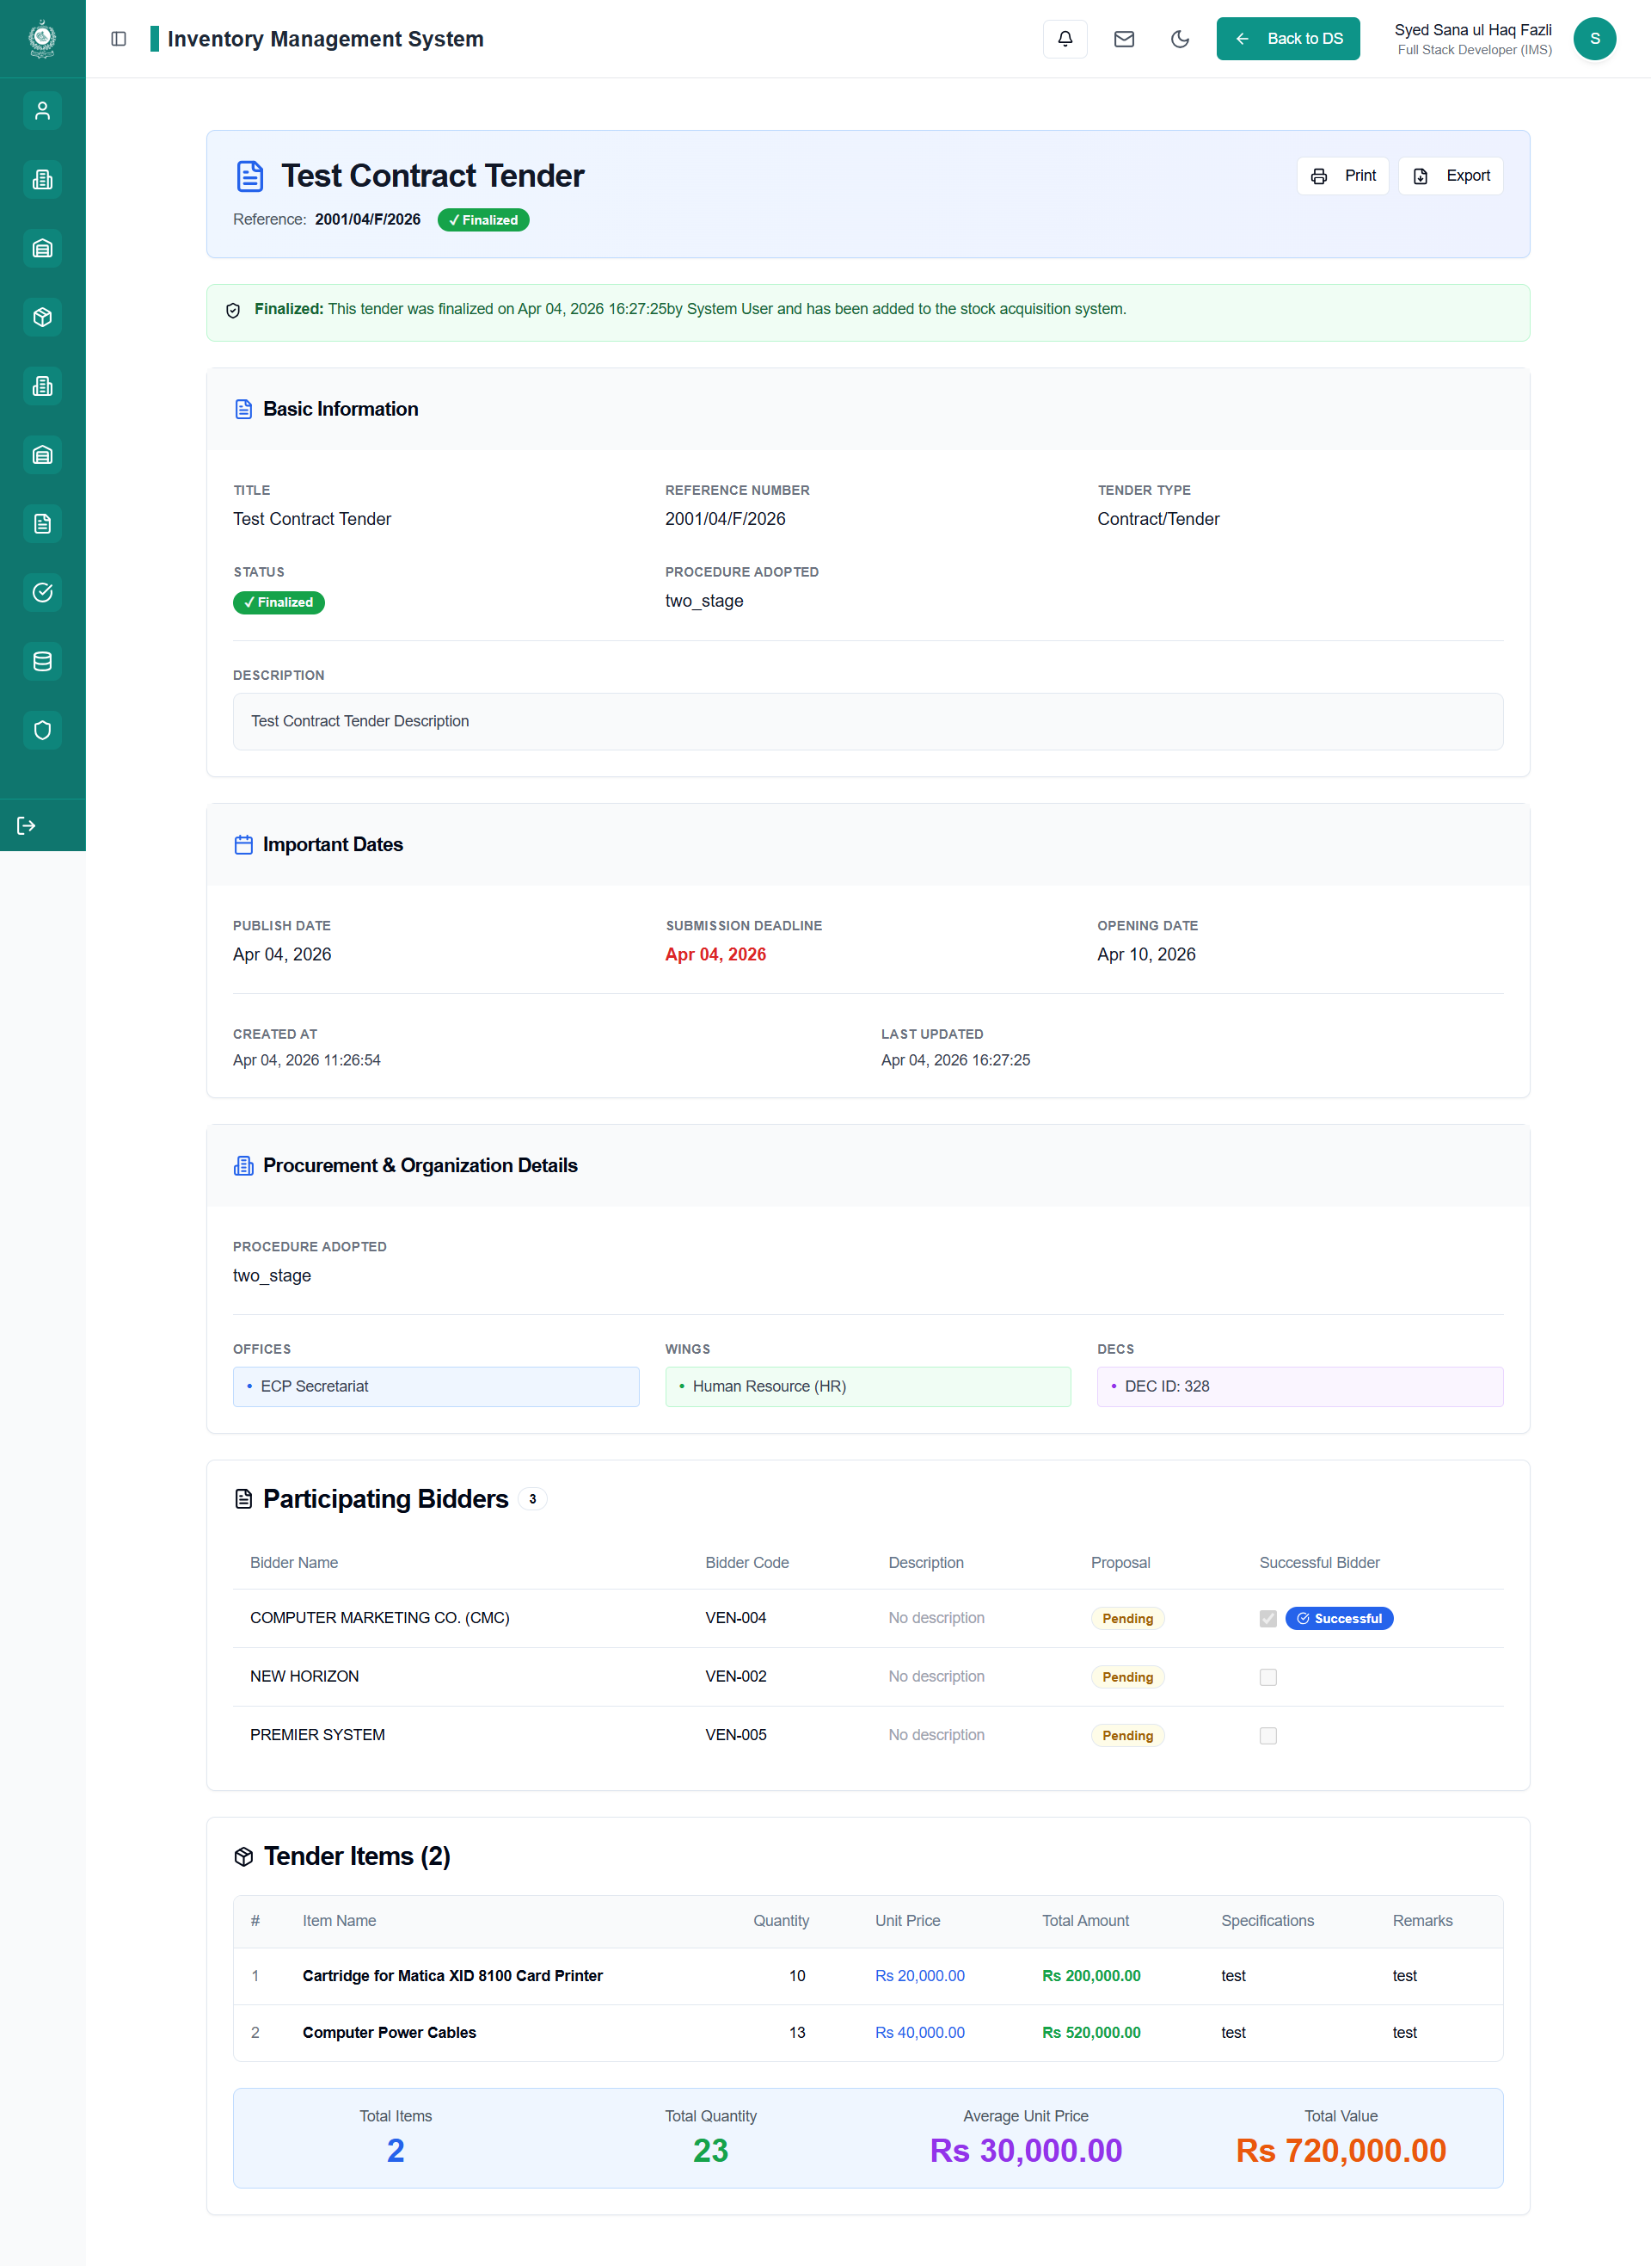
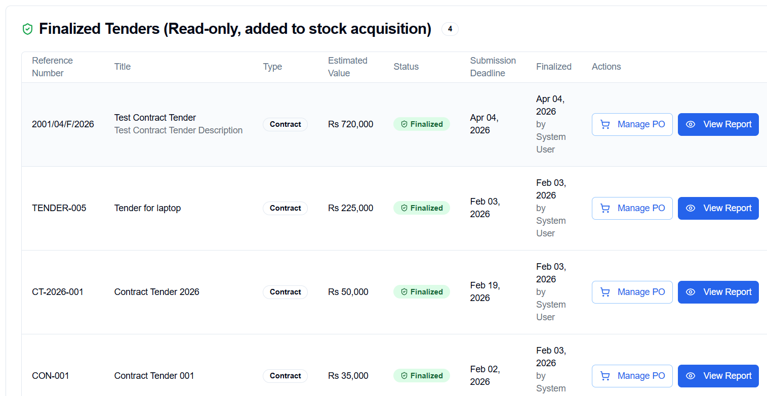
Contract Tender

Slide 12
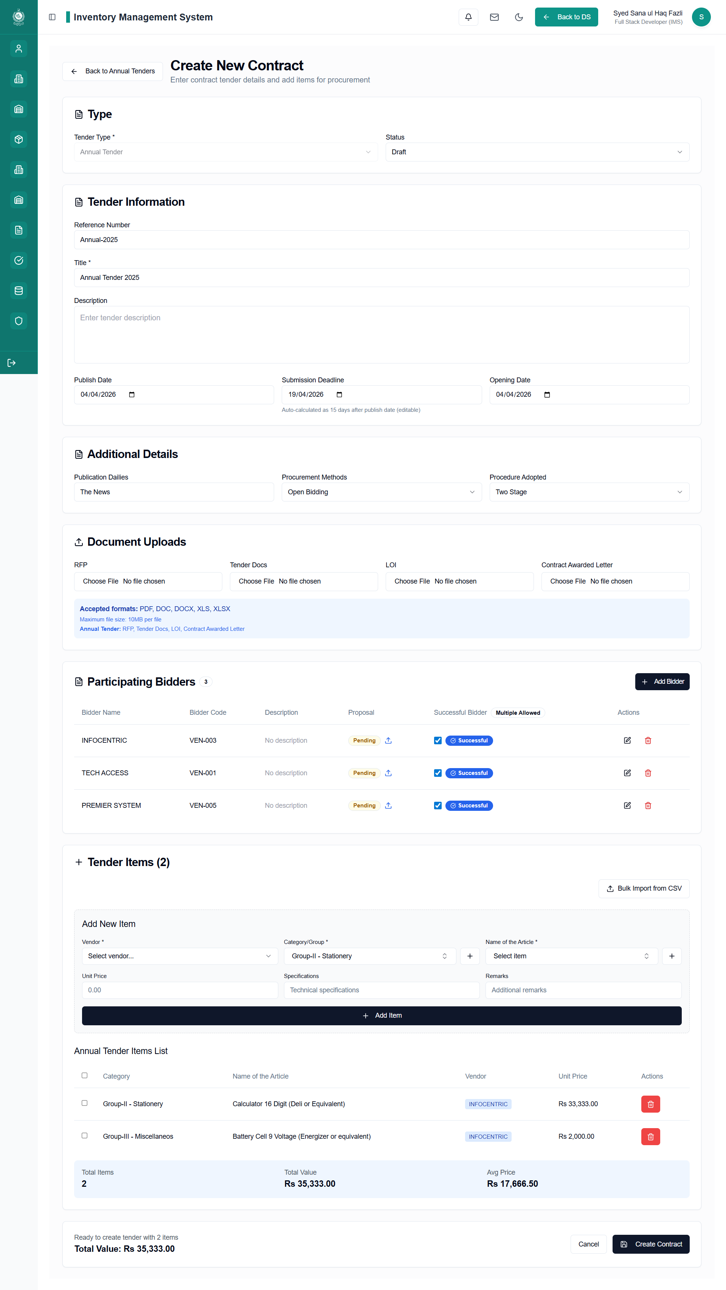
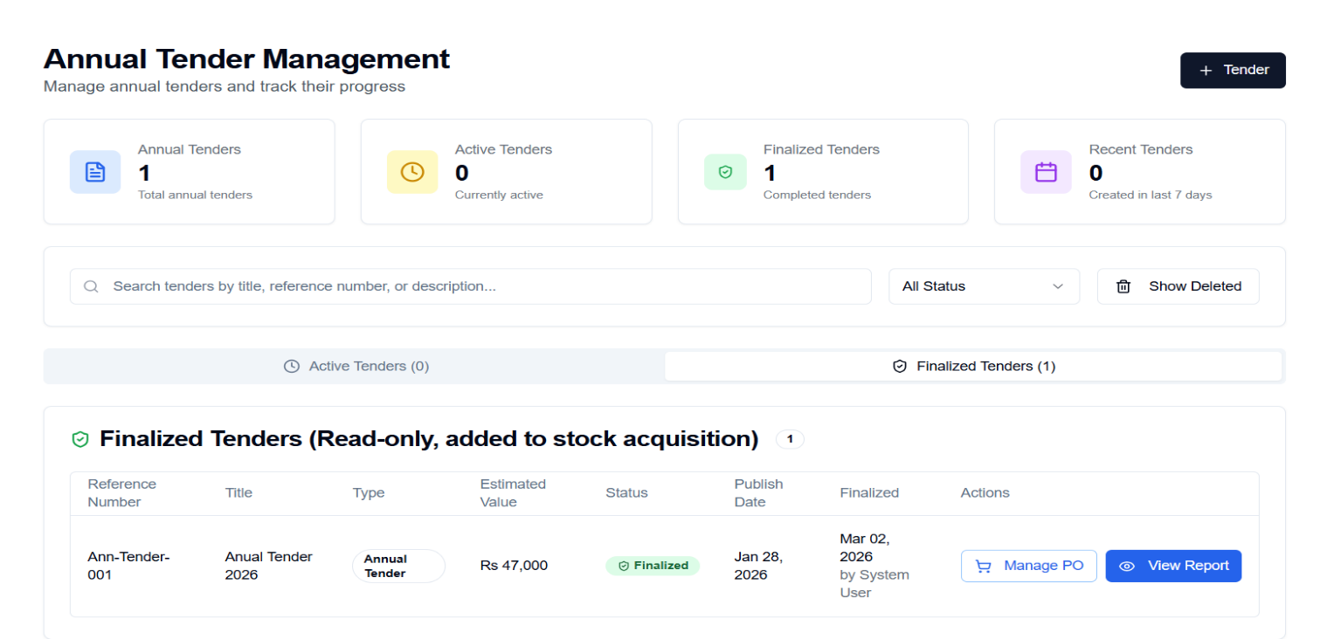
Annual Tender

Slide 13
STOCK ISSUANCE
CORE MODULES
Request generation from authorized Official/Officials
3-level approval workflow
Per-item decision making (Approve/Return/Reject)
Automatic inventory deduction

Slide 14
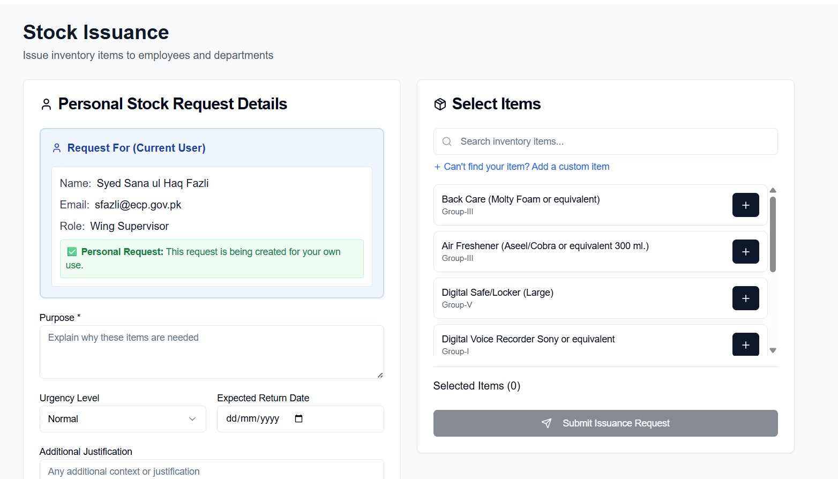
Stock Issuance

Slide 15
INVENTORY VERIFICATION
CORE MODULES
Physical stock verification by storekeepers
Verification request assignment
Reconciliation with system records

Slide 16
HIERARCHICAL INVENTORY
CORE MODULES
Admin Store (Central warehouse)
Wing Store (Department-level)
Personal Store (User-allocated items)

Slide 17
Main Operational Workflows
Stock Acquisition Steps
Request
01
Tender
02
Vendor Bids
03
Award
04
Delivery
05
Distribution
06

Slide 18
Main Operational Workflows
Stock Issuance Steps
Request
01
Tender
02
Vendor Bids
03
Award
04
Delivery
05
Distribution
06

Slide 19
Developed Work
✅ Real-time Stock Tracking
✅ Multi-Step Hierarchical Approval Workflows
✅ Complete Audit Trail
✅ Role-Based Access Control (RBAC)
✅ Three-Level Inventory Management
✅ Multiple Tender Types Support
✅ Digital Annual Framework Contracts
✅ Serial Number & Equipment Tracking
✅ Document Upload & Attachment Support
✅ Soft Delete with Data Recovery

Slide 20

THANK YOU

